Slide 1
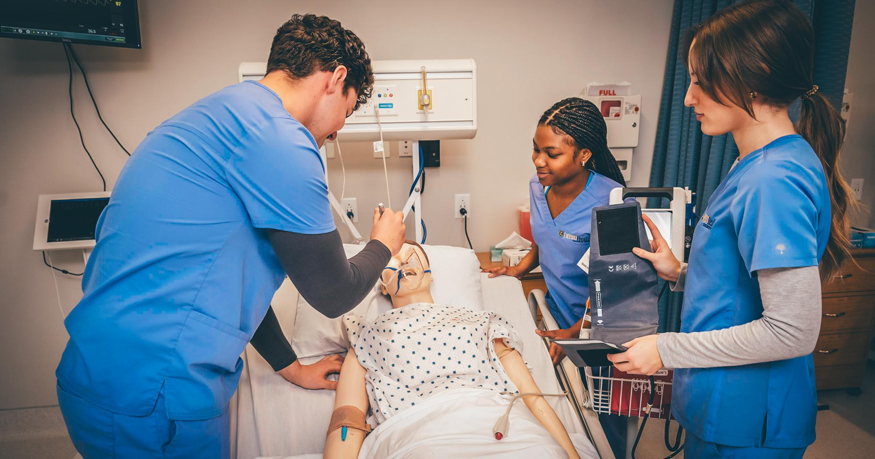
TrackED

Slide 2

TrackED: Nursing Student Tracking Web Application
ETSU Software Engineering I Team
Team: Mason, Katherine, Tyler, Will, Nick, Daniel
December 2025

Slide 3
Project Overview
Tracks nursing students during clinicals
Helps professors monitor progress & safety
Central dashboard for oversight and tasks

Slide 4
Team Members & Roles
Daniel – Frontend (UI, Dashboard, Calendar)
Mason – Login and Structure Designer
Katherine – ERD Designer
Tyler – Database/Endpoint Designer (Schema)
Will – Geolocation
Nick – Geolocation

Slide 5
Product Vision & Goals
Improve student safety & accountability
Real-time geolocation tracking
Role-based login system
Analytics dashboard
Clinical task management
Support ETSU Nursing Program with a centralized tracking system
Increase safety + accountability during clinical rotations
Provide quick access to student progress & task completion
Simplify coordination between professors and students

Slide 6
Key Features
Interactive task calendar
Role-based dashboards
Student geolocation simulation
Analytics & reports

Slide 7

Architecture Overview
ASP.NET MVC Architecture
Flow: Browser → Controller → Model → Database
Tech: C#, Razor, SQL Server

Slide 8
Detailed Design
ERD: Students, Professors, Tasks, Locations
Data Flow: Login → Dashboard → Task Management

Slide 9
Tools & Environment
Visual Studio 2022, .NET 8
C# Razor Pages
GitHub version control
Localhost mock testing
HTML, CSS, and Javascript
SQLite

Slide 10
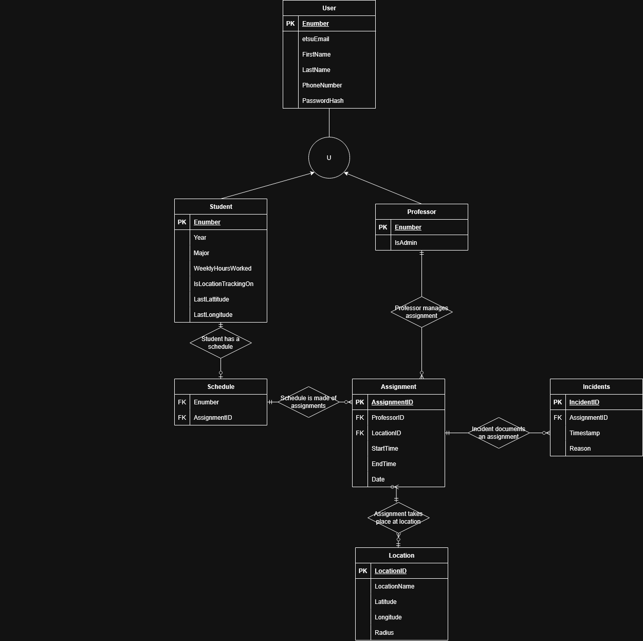
Database ERD
Designed so professors can create and manage assignments for their students
Designed to store student location every 60 seconds
Designed to store incidents of students leaving their designated areas

Slide 11
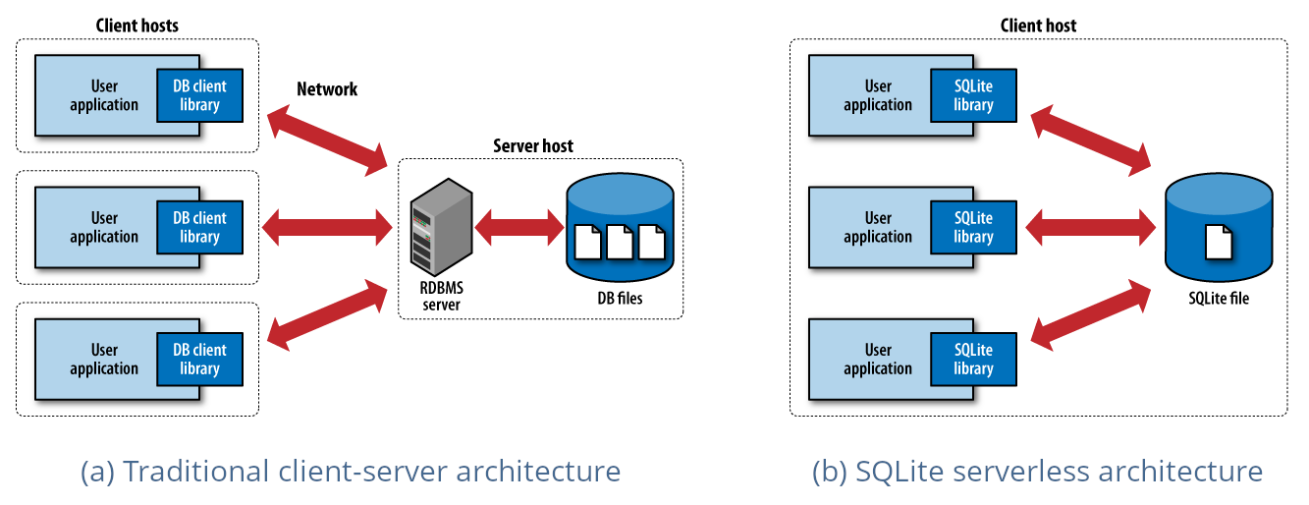
Database Implementation
A relational database implemented using Entity Framework Core
ENumbers were used as Primary Keys for all Users
TPH inheritance for User -> Professor and Student
Other Primary Keys were auto incremented
CURD endpoints were created to interact with Database

Slide 12
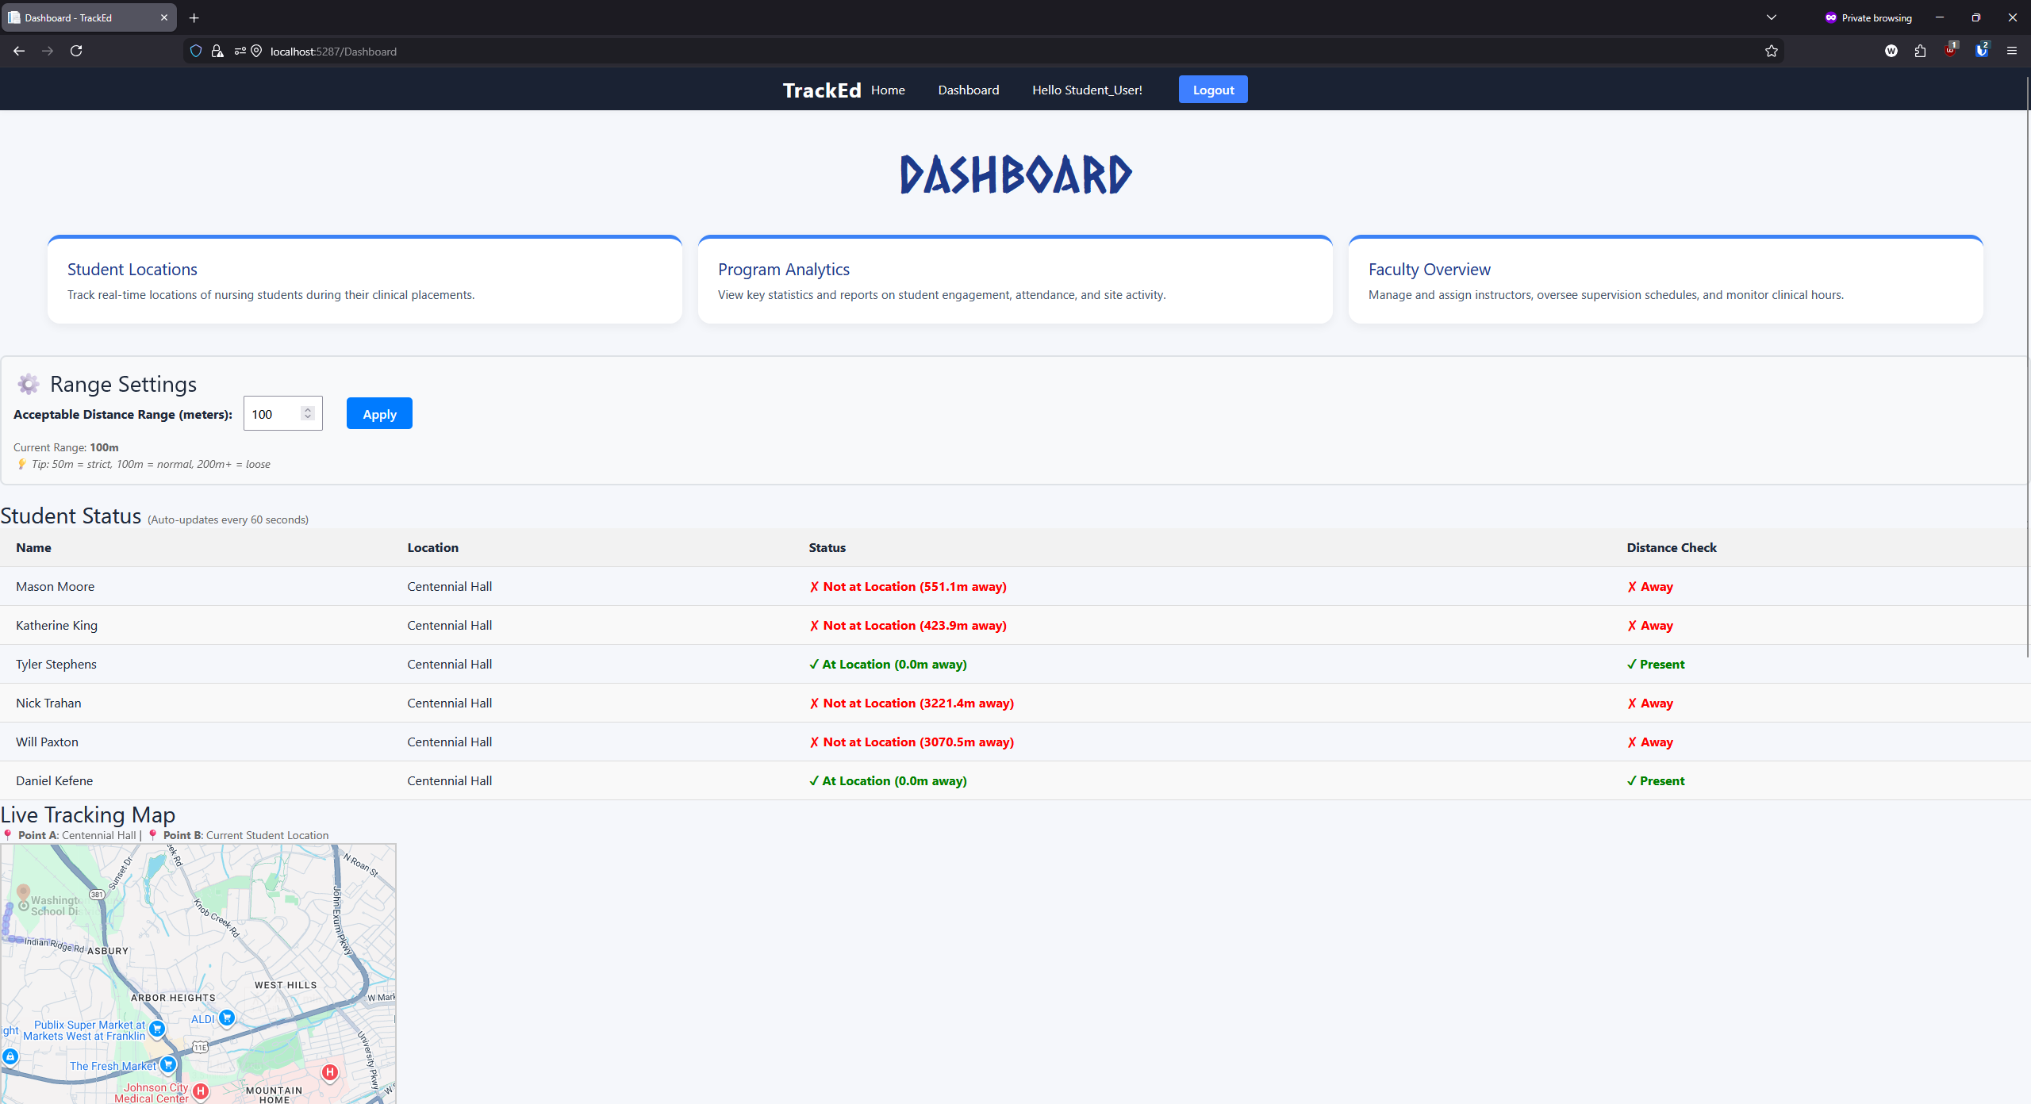
Teacher View

Slide 13
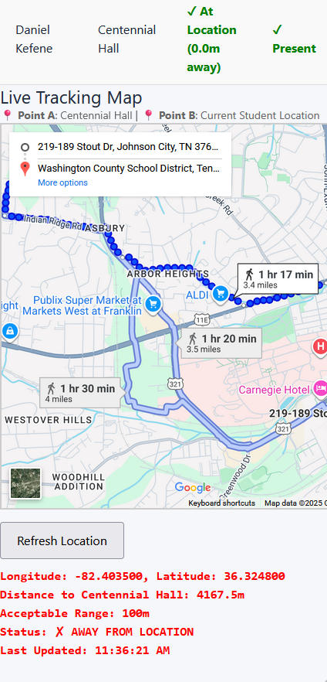
Features
Checks student location every 60 seconds
Can accurately determine student location within 15 feet

Slide 14
Challenges & Lessons Learned
Backend integration issues
Authentication complexity
Clearer data structures
Some of us had to install applications to see our work
Git merge conflicts between frontend & backend
Authentication setup complexity
Geolocation API restrictions → needed simulation
Time constraints across 5 sprints
Learning curve with Entity Framework migrations

Slide 15

Sprint Goals and Achievements
Sprint 1: The Sprint Goal was to establish a base for the project by both researching technologies to apply to the project and creating structures for the application and the database.
Sprint 2: The Sprint Goal was to set up the last important pieces to help the project continue properly. This was goals like fixing the Kanban Board and finding the final API.
Sprint 3:The main Sprint goals we were working toward during this period were getting the location tracking started and building the log in system for the web page.
Sprint 4: For this sprint we worked on dividing up the last tasks needed for a minimum viable product, along with finishing the geo location tracking and frontend final touches.
Sprint 5: The goal of this sprint was to wrap up the project, combine front and back end, and create a presentable product. In the end, we achieved a functional product.

Slide 16
Future Improvements & Wrap-Up
Connect calendar to backend database
Adding Isolated Student & Faculty Views
Expand analytics & add mobile support
TrackED enhances supervision in ETSU Nursing

